Slide 1
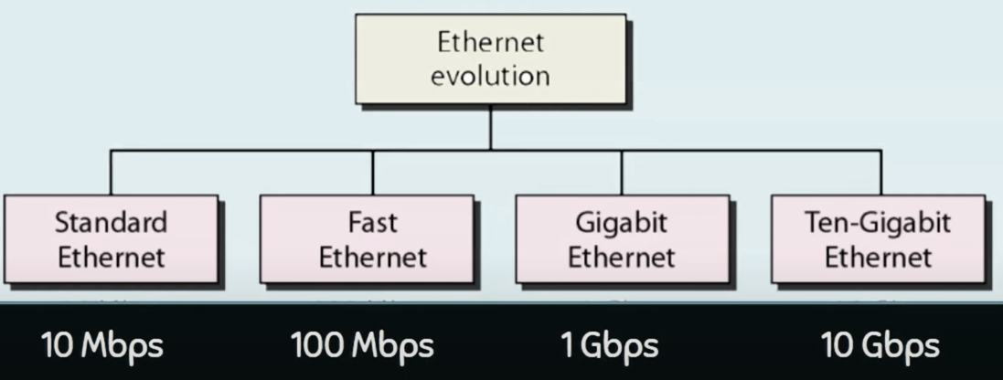
Ethernet
Ethernet is a set of technologies and protocols that are used primarily in LANs. However, Ethernet can also be used in MANs and even WANs. It was first standardized in the 1980s as IEEE 802.3 standard.

Slide 2
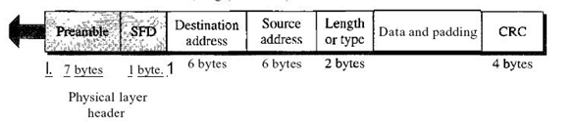
Preamble This field contains 7 bytes (56 bits) of alternating Os and Is that alert the receiving system to the coming frame and enable it to synchronize its clock if it's out of synchronization. The pattern provides only an alert and a timing pulse. The 56-bit pattern allows the stations to miss some bits at the beginning of the frame. The preamble is actually added at the physical layer and is not (formally) part of the frame.
Start frame delimiter (SFD) This field (1 byte: 10101011) signals the beginning of the frame. The SFD warns the station or stations that this is the last chance for synchronization. The last 2 bits are (llh and alert the receiver that the next field is the destination address. This field is actually a flag that defines the beginning of the frame. We need to remember that an Ethernet frame is a variable-length frame. It needs a flag to define the beginning of the frame. The SFD field is also added at the physical layer.
Destination address (DA) This field is six bytes (48 bits) and contains the link layer address of the destination station or stations to receive the packet. When the receiver sees its own link-layer address, or a multicast address for a group that the receiver is a member of, or a broadcast address, it decapsulates the data from the frame and passes the data to the upper layer protocol defined by the value of the type field.

Slide 3
Source address (SA) This field is also six bytes and contains the link-layer address of the sender of the packet. Type This field defines the upper-layer protocol whose packet is encapsulated in the frame. This protocol can be IP, ARP, OSPF, and so on. In other words, it serves the same purpose as the protocol field in a datagram and the port number in a segment or user datagram. It is used for multiplexing and de-multiplexing.
Data This field carries data encapsulated from the upper-layer protocols. It is a minimum of 46 and a maximum of 1500 bytes. We discuss the reason for these minimum and maximum values shortly. If the data coming from the upper layer is more than 1500 bytes, it should be fragmented and encapsulated in more than one frame.

Slide 4
Preamble − It is the starting field that provides alert and timing pulse for transmission.
Destination Address − It is a 6-byte field containing the physical address of destination stations.
Source Address − It is a 6-byte field containing the physical address of the sending station.
Length − It stores the number of bytes in the data field.
Data and Padding − This carries the data from the upper layers.
CRC − It contains error detection information.

Slide 5
Media Access Control (MAC)
The Media Access Control (MAC) data communication Networks protocol sub-layer, also known as the Medium Access Control, is a sub-layer of the data link layer specified in the seven-layer OSI model. The medium access layer was made necessary by systems that share a common communications medium. Typically these are local area networks. The MAC layer is the “low” part of the second OSI layer, the layer of the “data link”.
All Wi-Fi data packets so carry a pack Logical Link Control, which contains itself packets from the upper network layers. The header of a packet LLC indicates the type of layer 3 protocol in it: most of the time, it is IP protocol, but it could be another protocol, such as IPX (Internet Packet Exchange) for example.

Slide 6
Network Devices (Hub, Repeater, Bridge, Switch, Router, Gateways and router)
Repeater – A repeater operates at the physical layer. Its job is to regenerate the signal over the same network before the signal becomes too weak or corrupted so as to extend the length to which the signal can be transmitted over the same network. An important point to be noted about repeaters is that they do not amplify the signal. When the signal becomes weak, they copy the signal bit by bit and regenerate it at the original strength.
Hub – A hub is basically a multiport repeater. A hub connects multiple wires coming from different branches, for example, the connector in star topology which connects different stations. Hubs cannot filter data, so data packets are sent to all connected devices.

Slide 7
Switch – A switch is a multi port bridge with a buffer and a design that can boost its efficiency(large number of ports imply less traffic) and performance. Switch is data link layer device. Switch can perform error checking before forwarding data, that makes it very efficient as it does not forward packets that have errors and forward good packets selectively to correct port only.
Routers – A router is a device like a switch that routes data packets based on their IP addresses. Router is mainly a Network Layer device. Routers normally connect LANs and WANs together and have a dynamically updating routing table based on which they make decisions on routing the data packets. Router divide broadcast domains of hosts connected through it.
Gateway – A gateway, as the name suggests, is a passage to connect two networks together that may work upon different networking models. They basically works as the messenger agents that take data from one system, interpret it, and transfer it to another system. Gateways are also called protocol converters and can operate at any network layer. Gateways are generally more complex than switch

Slide 8
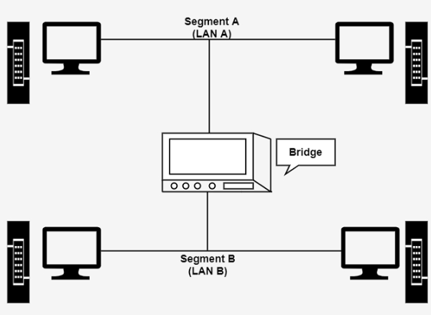
Bridge
A bridge in a computer network is a device used to connect multiple LANs together with a larger Local Area Network (LAN). The mechanism of network aggregation is known as bridging. The bridge is a physical or hardware device but operates at the OSI model’s data link layer and is also known as a layer of two switches. The primary responsibility of a switch is to examine the incoming traffic and determine whether to filter or forward it.
Basically, a bridge in computer networks is used to divide network connections into sections, now each section has separate bandwidth and a separate collision domain. Here bridge is used to improve network performance.

Slide 9
Types of Bridges
Transparent Bridges
It is also called learning bridges. Bridge construct its table of terminal addresses on its own as it implements connecting two LANs. It facilitates the source location to create its table. It is self-updating. It is a plug and plays bridge.
Source Routing Bridge
This sending terminal means the bridges that the frames should stay. This type of bridge is used to prevent looping problem.

Slide 10
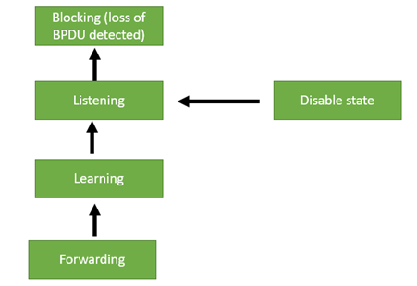
Spanning Tree Bridge
Where two bridges are used to interconnect the same two computer network segments, spanning tree is a protocol that allows the bridges to exchange information so that only one of them will handle a given message that is being sent between two computers within the network. The spanning tree protocol prevents the condition known as a bridge loop.

Slide 11
Blocking State
Block state is a non-designated port, and it is never participating in frame forwarding. Its time limit is 20 sec or unlimited. An interface always enters the blocking state when you enable STP.
Listening State
The listening state is the first state. It is an interface that is entered after the blocking state. The interface helps you to determine that the interface that should participate in frame forwarding.
Learning State
Learning state helps to prepare for participating in frame forwarding. The interface allows us to enter the learning state from the listening slate.
Forwarding State:
An interface in the forwarding state form the forward frames. This interface enters the forwarding state from the learning state which performs
Disabled State
This state does not participate in the Spanning Tree loop because the port is administratively disabled, and its timing is also unlimited.

Slide 12
Five ports used in STP
Root port: The root port is a port that has the lowest cost path to the root bridge.
Designated port: The designated port is a port that forwards the traffic away from the root bridge.
Blocking port: The blocking port is a port that receives the frames, but it neither forwards nor sends the frames. It simply drops the received frames.
Backup port: The backup port is a port that provides the backup path in a spanning
tree if a designated port fails. This port gets active immediately when the designated port fails.
Alternate port: The alternate port is a port that provides the alternate path to the root bridge if the root bridge fails.

